Slide 1
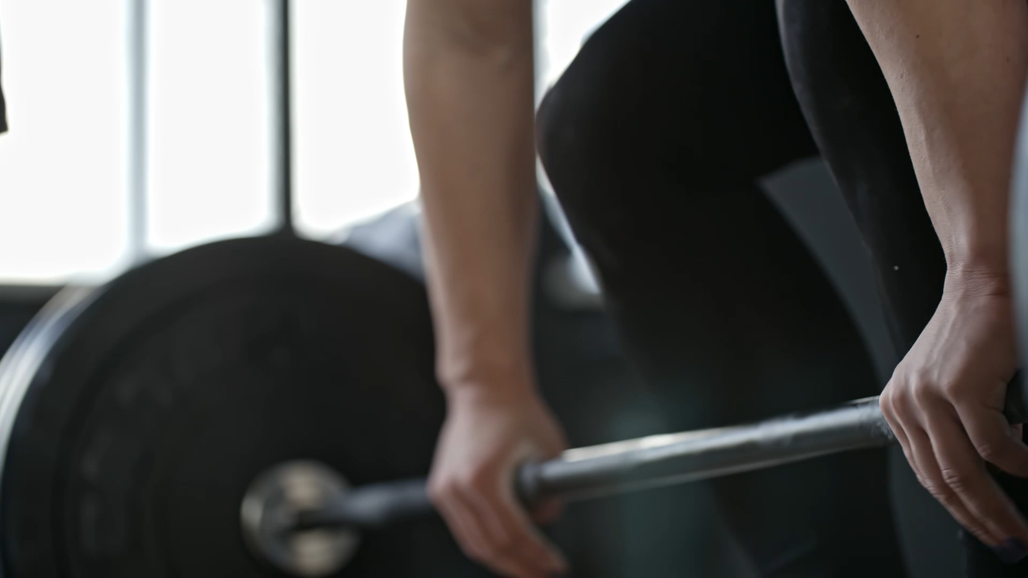
Chatbot and Generative ia
Muscular training Chatbot
Group 10 – Damien Lin – Clément Bosc

Slide 2
Summary
Why a sport chatbot ?
Our innovations
How did we make it ?
The result

Slide 3
The motivations behind this chatbot
A lack of Chatbot on this topic
Something that we could use

Slide 4

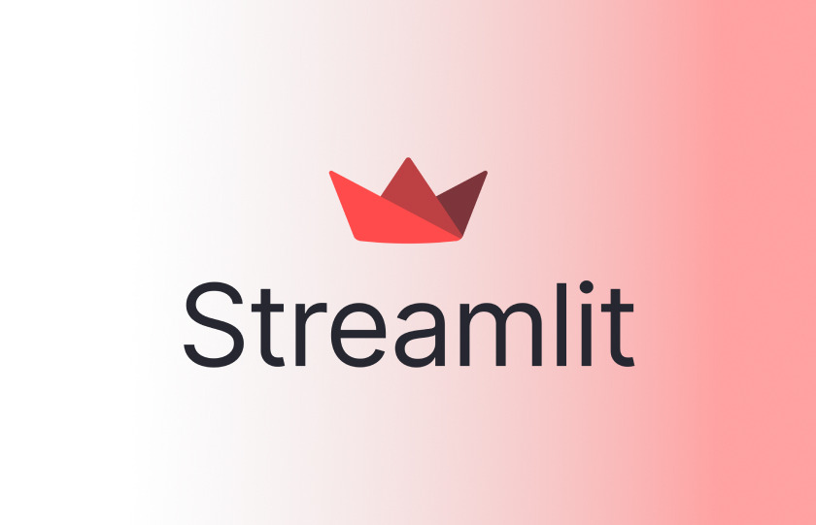
The innovating parts
Workout Youtube’s video
A user interface with Streamlit

Slide 5
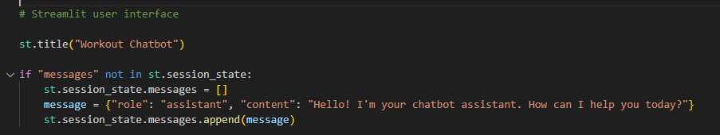
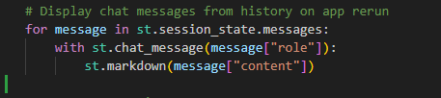
The executions steps
We start the bot

Slide 6
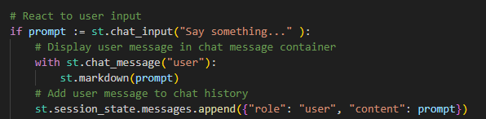
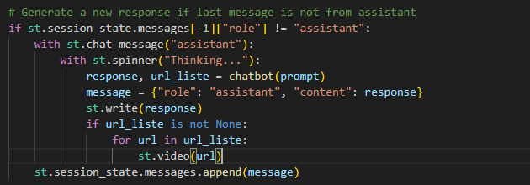
The executions steps
The chatbot will receive the user message
And it answer with text or a youtube video

Slide 7
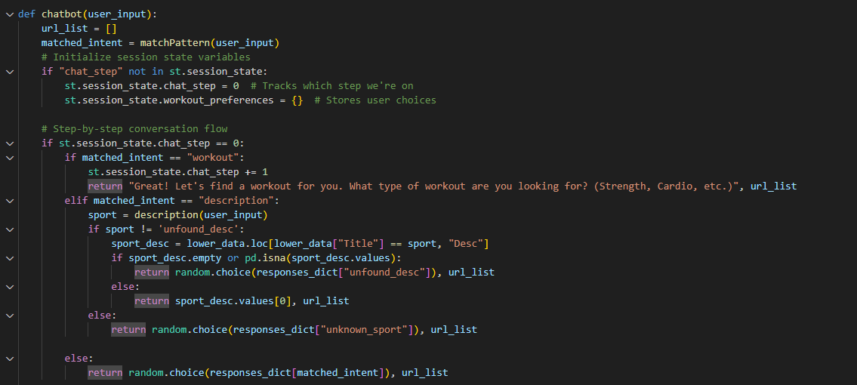
The executions steps
Chatbot with chat_step = 0 executes basic chatbot answers

Slide 8
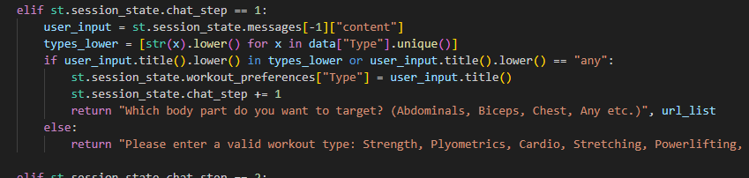
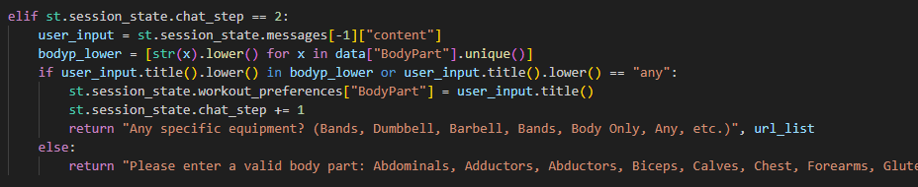
The executions steps
Chat_step = 1 : Ask for the type of workout
Chat_step = 2 : Ask for the part of the body
you want to work on

Slide 9
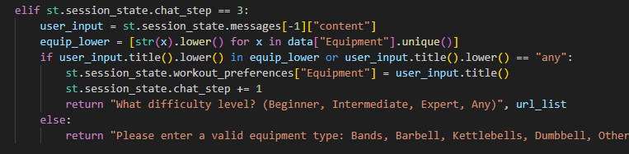
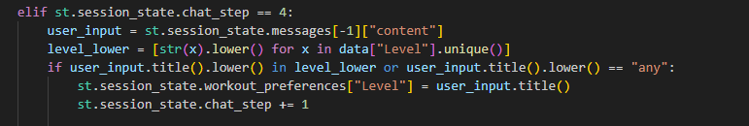
The executions steps
Chat_step = 3 : Ask for the type of equipment you need
Chat_step = 4 : Ask for the part of the level for the workout

Slide 10
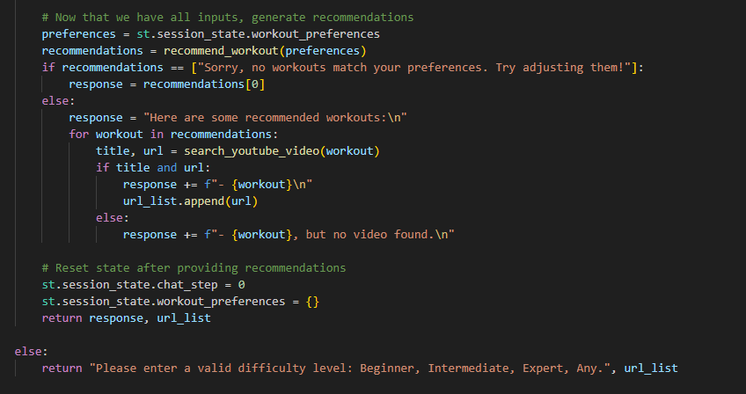
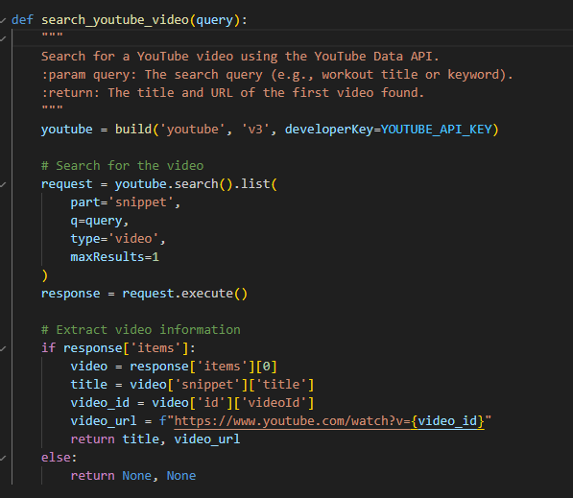
The executions steps
At the end generates a video found on youtube thanks to the query

Slide 11
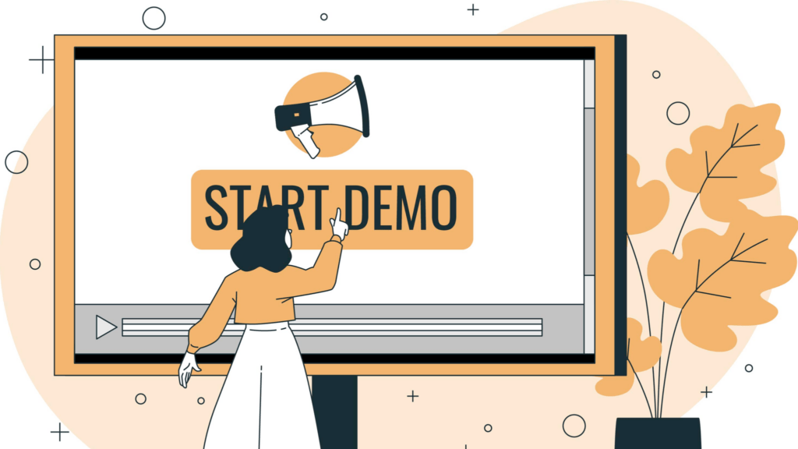
The final result

Slide 12
And if we had more time…
More trainings and exercises
Use the user’s data (performance on the exercises, weight, etc..)

